Slide 1
Simple explanation for Numbering System Calculator
Design
Form
Calculator
The oldest version
Need keyboard and mouse
Manual design
Flexible
The newest version
Need mouse only
Hard for laptop user to click button using mouse

Slide 2
What the discussion of this PowerPoint
decide the design to used (calculator/form/both)
explanation of how to use the system
improvement for the system
bug findings

Slide 3
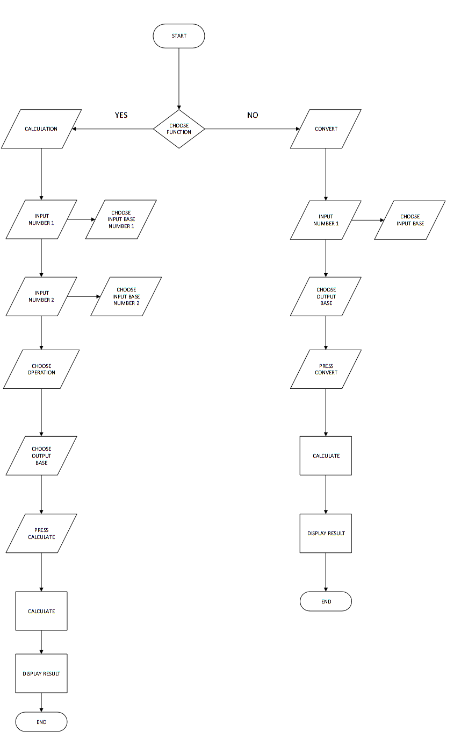
This is latest flowchart for form version
But it will be different with the calculator flowchart because it is different:-
in select base number for input and the select output base at Calculation process
For calculator, the flowchart will be one only base number selected. All of them will only use one base number. So, the Calculation will do in one base number only

Slide 4

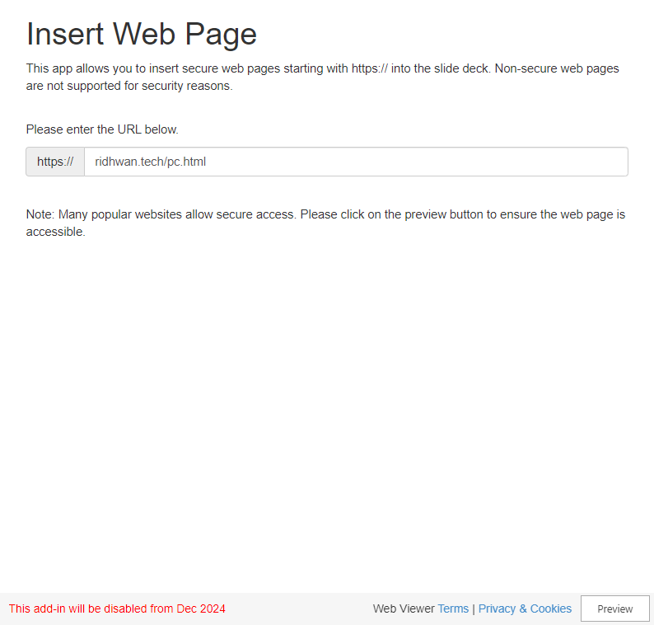
This the Form design
Direct link: https://ridhwan.tech/pc.html
you guys could interact with the website at this left. Ctrl+R to refresh
My own opinion
same
Good for laptop but not bad for phone ->
Keyboard and mouse requirement.
Phone need to pop up the keyboard to give the input
Simple to use
Direct instruction for using it
Not too much animation
Too simple
Not too much creative (for me lah)

Slide 5


This the Calculator design
Direct link: https://ridhwan.tech/mobile.html
you guys could interact with the website at this left. Ctrl+R to refresh
My own opinion
same
Good for phone but not laptop
As I explain the pop up of keyboard is annoy, tab button with finger is convenient
Hard to move mouse to tap the button using pc and prefer input using laptop for fast input
Instruction not really good
Since I want to built it compact, I don’t know if people understand the function of N1 and N2
Compact and unique
User can view the number really good,
Creative(unique)

Slide 6
The Suggestion or Questions
Do we need both of the design or one only?
If both, did we need to use 1 flowchart or both?
If both, did we need to make the design available for pc and mobile or one each? ->
I mean, the website will automatically show the calculator for mobile and show the form for pc
If both available for these device, I would like to add a button to change the design.
If one only, which one did you guys prefer?
Is the color already good?
What need to improvise the website?

Slide 7
Any Question could share in Whatapps group or DM me.
More convenient if you share them in Whatapps group.

